Slide 1

How does a bike-share navigate speedy success?
Xern Mottley
February 2023

Slide 2
Table of contents
Purpose Statement
Review of findings
Conclusions drawn
Recommendations

Slide 3

Purpose statement
Identify the key differences between casual and annual members in terms of their behavior using the available data, and recommend strategies for Cyclstic to convert casual members into annual members.

Slide 4

Review of findings

Slide 5
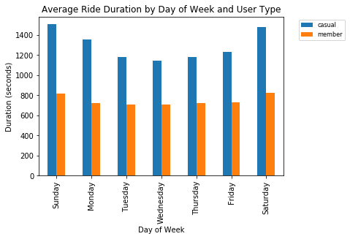
Ride Duration
Notes:
Casual members, on average, took longer rides per ride compared to annual members.

Slide 6
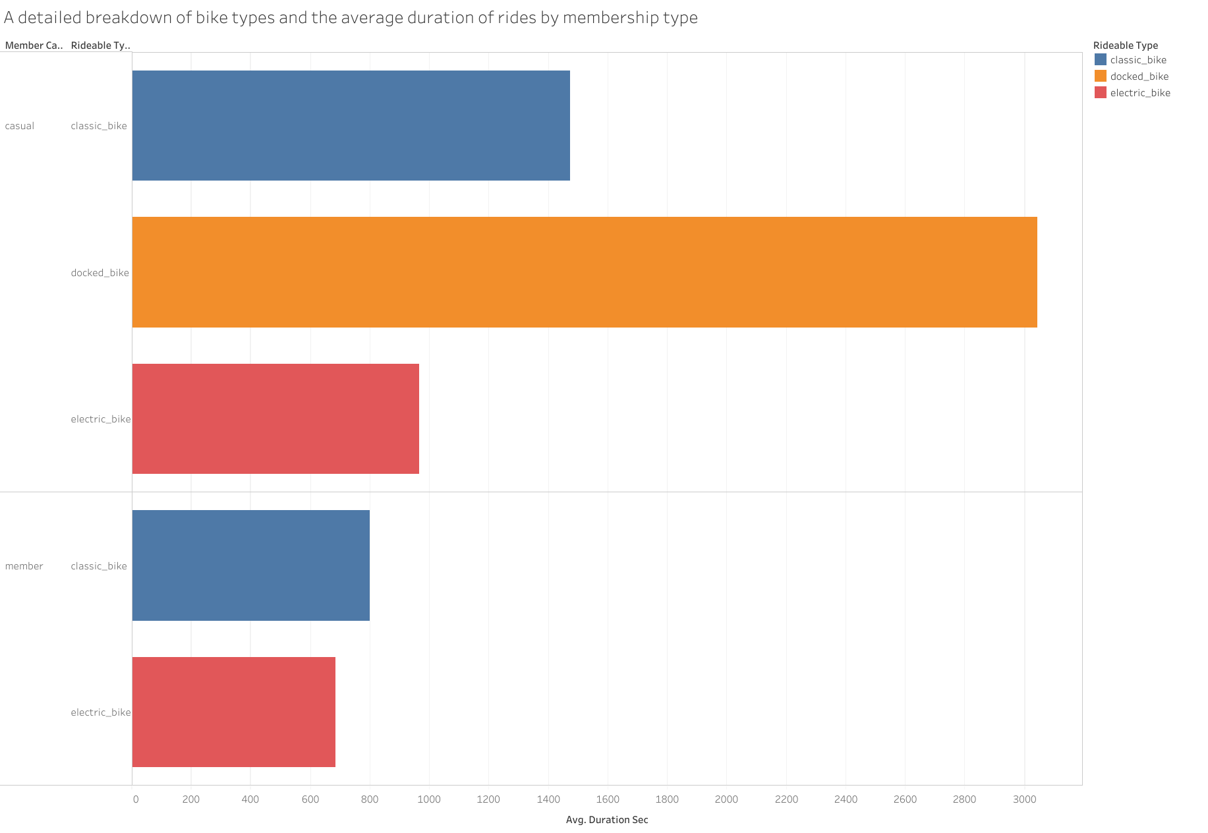
Ride Duration cont.

Slide 7
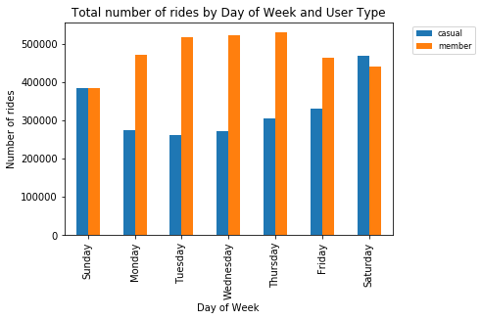
Ride Frequency
Notes:
Annual members higher during weekdays, equal with casual members on Sundays and higher for casual members on Saturdays.

Slide 8
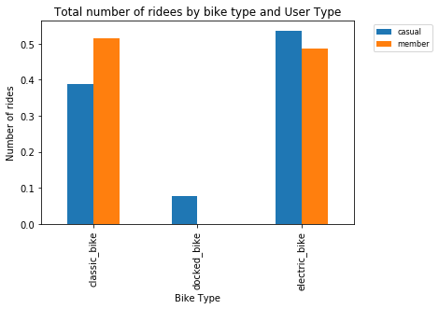
Bike Type Preference
Notes:
Annual members use classic and electric bikes equally, with classic bikes having 51% usage, electric bikes with 49% usage, and docked bikes with 0%. Casual members prefer electric bikes with 54% usage, followed by classic bikes with 39% and docked bikes with 7%.

Slide 9
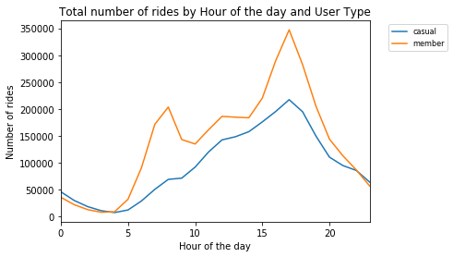
Usage Patterns
Notes:
The usage patterns of the bikes by annual and casual members during the day were found to be similar.

Slide 10
Conclusions
Casual members have on average longer rides, than annual members
01
Annual members are more active during the week while casual members are more active on weekends
02
Casual members prefer electric bikes while annual members equally like electric and classic bikes with docked bikes being the least favored
03
The patterns of riding during the day is similar between annual and casual members
04

Slide 11

Recommendations
Increase the rates for electric bike usage for casual users, while simultaneously making it more accessible for annual members and market those perks heavily to casual members
Market the benefits of riding long with the annual membership while

